Slide 1

Database Management System
Lab # 5 (SQL Constraints & DML)

Slide 2
SQL CONSTRAINTS
SQL constraints are used to specify rules for the data in a table.
If there is any violation between the constraint and the data action, the action is aborted by the constraint.
Constraints can be specified when the table is created (inside the CREATE TABLE statement) or after the table is created (inside the ALTER TABLE statement).

Slide 3
SQL CREATE TABLE + CONSTRAINT Syntax
CREATE TABLE table_name(
column_name1 data_type(size) constraint_name,
column_name2 data_type(size) constraint_name,
column_name3 data_type(size) constraint_name,....);

Slide 4
TYPES OF CONSTRAINTS
In SQL, we have the following constraints:
NOT NULL
UNIQUE
PRIMARY KEY
FOREIGN KEY
CHECK
DEFAULT

Slide 5
NULL CONSTRAINT
Indicates that a column cannot store NULL value
The NOT NULL constraint enforces a column to NOT accept NULL values.
The NOT NULL constraint enforces a field to always contain a value. This means that you cannot insert a new record, or update a record without adding a value to this field.

Slide 6
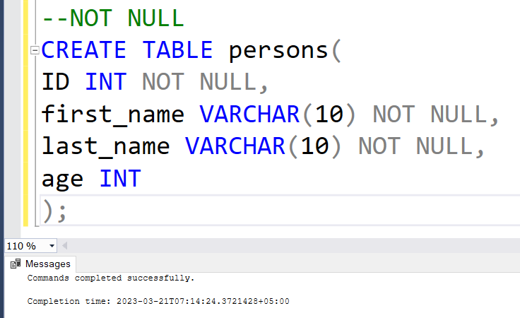
EXAMPLE-NULL CONSTRAINT
--NOT NULL
CREATE TABLE persons(
ID INT NOT NULL,
first_name VARCHAR(10) NOT NULL,
last_name VARCHAR(10) NOT NULL,
age INT);

Slide 7
UNIQUE CONSTRAINT
Ensures that each row for a column must have a unique value
The UNIQUE constraint uniquely identifies each record in a database table.
The UNIQUE and PRIMARY KEY constraints both provide a guarantee for uniqueness for a column or set of columns.
A PRIMARY KEY constraint automatically has a UNIQUE constraint defined on it.
Note that you can have many UNIQUE constraints per table, but only one PRIMARY KEY constraint per table.

Slide 8
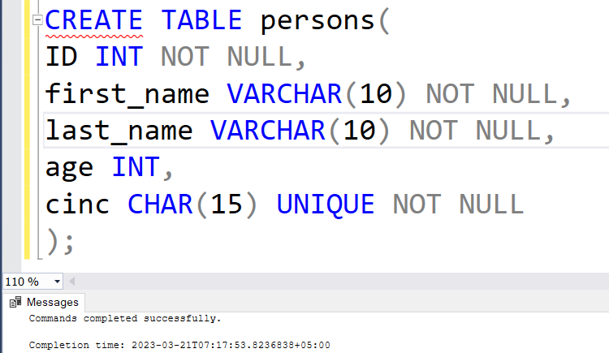
EXAMPLE-UNIQUE CONSTRAINT
--NOT NULL
CREATE TABLE persons(
ID INT NOT NULL,
first_name VARCHAR(10) NOT NULL,
last_name VARCHAR(10) NOT NULL,
age INT,
cinc CHAR(15) UNIQUE NOT NULL);

Slide 9
PRIMARY KEY CONSTRAINT
A combination of a NOT NULL and UNIQUE. Ensures that a column (or combination of two or more columns) have an unique identity which helps to find a particular record in a table more easily and quickly
The PRIMARY KEY constraint uniquely identifies each record in a database table.
Primary keys must contain UNIQUE values.
A primary key column cannot contain NULL values.
Most tables should have a primary key, and each table can have only ONE primary key.

Slide 10
EXAMPLE-PRIMARY KEY CONSTRAINT
-- PRIMARY KEY
CREATE TABLE persons(
ID INT IDENTITY(1,1) PRIMARY KEY,
first_name VARCHAR(10) NOT NULL,
last_name VARCHAR(10) NOT NULL,
age INT);

Slide 11
FOREIGN KEY CONSTRAINT
Ensure the referential integrity of the data in one table to match values in another table
A FOREIGN KEY in one table points to a PRIMARY KEY in another table.

Slide 12
EXAMPLE-FOREIGN KEY CONSTRAINT
CREATE TABLE Orders ( OrderID int NOT NULL, OrderNumber int NOT NULL, PersonID int, PRIMARY KEY (OrderID), CONSTRAINT FK_PersonOrder FOREIGN KEY (PersonID) REFERENCES Persons(PersonID) );

Slide 13
CHECK CONSTRAINT
Ensures that the value in a column meets a specific condition.
The CHECK constraint is used to limit the value range that can be placed in a column.
If you define a CHECK constraint on a single column it allows only certain values for this column.
If you define a CHECK constraint on a table it can limit the values in certain columns based on values in other columns in the row.

Slide 14
EXAMPLE-CHECK CONSTRAINT
-- CHECK CONSTRAINT
CREATE TABLE persons(
PersonID INT IDENTITY(1,1) NOT NULL PRIMARY KEY,
first_name VARCHAR(10) NOT NULL,
last_name VARCHAR(10) NOT NULL,
age INT,
city VARCHAR(25),
CONSTRAINT CHK_person CHECK (age >= 18 AND city= 'Karachi'));

Slide 15
DEFAULT CONSTRAINT
Specifies a default value when specified none for this column.
The DEFAULT constraint is used to insert a default value into a column.
The default value will be added to all new records, if no other value is specified.

Slide 16
EXAMPLE-DEFAULT CONSTRAINT
-- DEFAULT
CREATE TABLE persons(
PersonID INT IDENTITY(1,1) NOT NULL PRIMARY KEY,
first_name VARCHAR(10) NOT NULL,
last_name VARCHAR(10) NOT NULL,
age INT,
city VARCHAR(25) DEFAULT 'Karachi',
CONSTRAINT CHK_person CHECK (age >= 18 AND city= 'Karachi'));

Slide 17
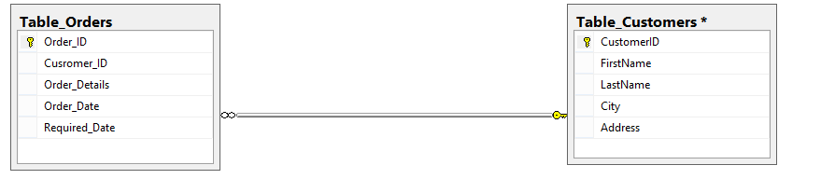
Lab Tasks
Apply Not Null Constraint on all columns .
Apply primary key constraint in OrderID and customer ID.
Apply foreign key constraint on Customer _ID in Order table.
Apply check constraint on city (allow Karachi, Islamabad, Lahore only).
Set the default value of City as ‘Karachi’.
Add CNIC column in Customer table with unique constraint.

Slide 18
RECAP: DATA DEFINITION LANGUAGE
DDL is a standard subset of SQL that is used to define tables (database structure), and other metadata related things.
DDL statements create, modify, and remove database objects such as tables, indexes, and users.
The most important DDL statements in SQL are:
CREATE DATABASE - creates a new database
CREATE TABLE - creates a new table
ALTER TABLE - modifies a table
DROP TABLE - deletes a table

Slide 19
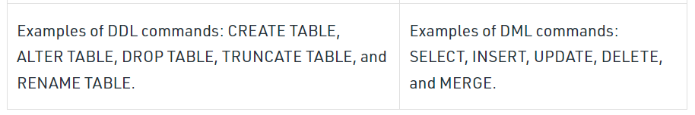
DDL vs DML

Slide 20
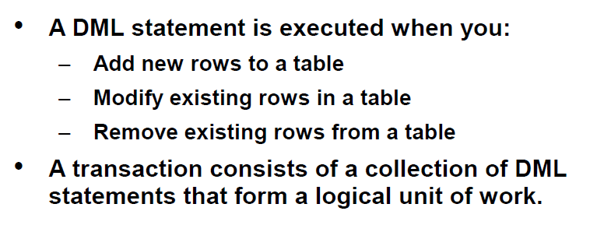
DML (Data Manipulation Language)

Slide 21
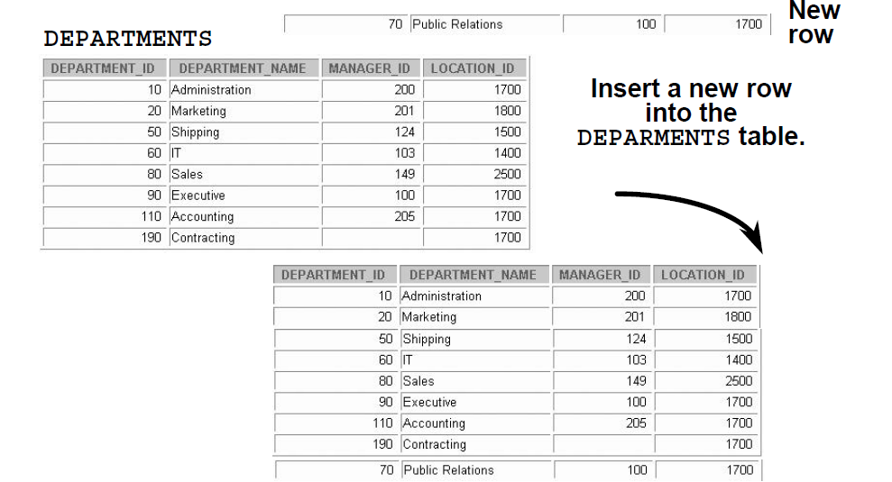
Adding a New Row to a Table

Slide 22
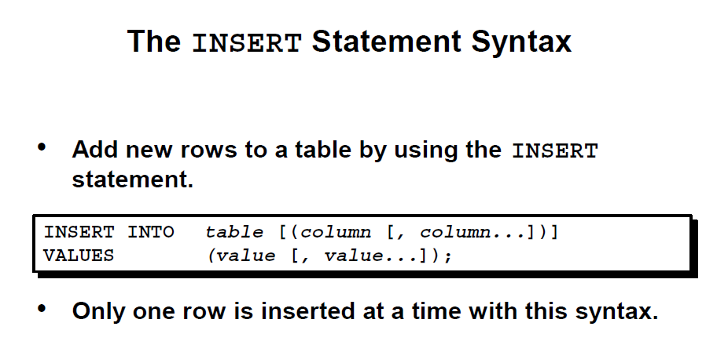
Insert Statement

Slide 23
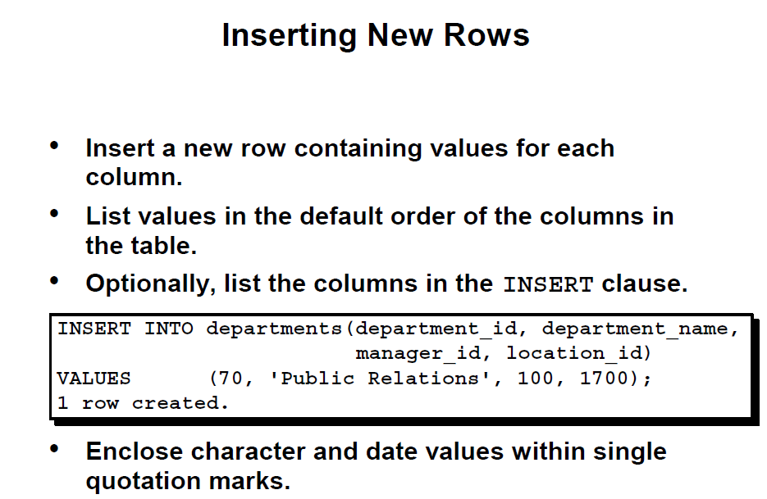
Inserting New Rows

Slide 24
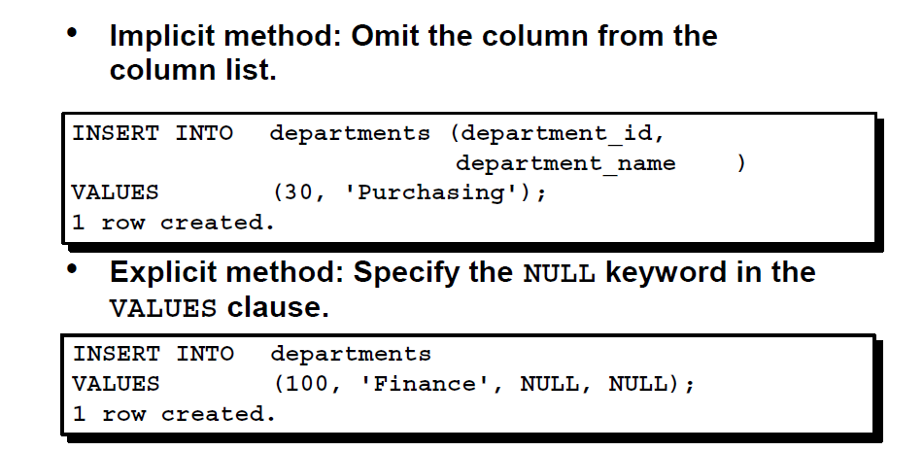
Inserting New Rows

Slide 25
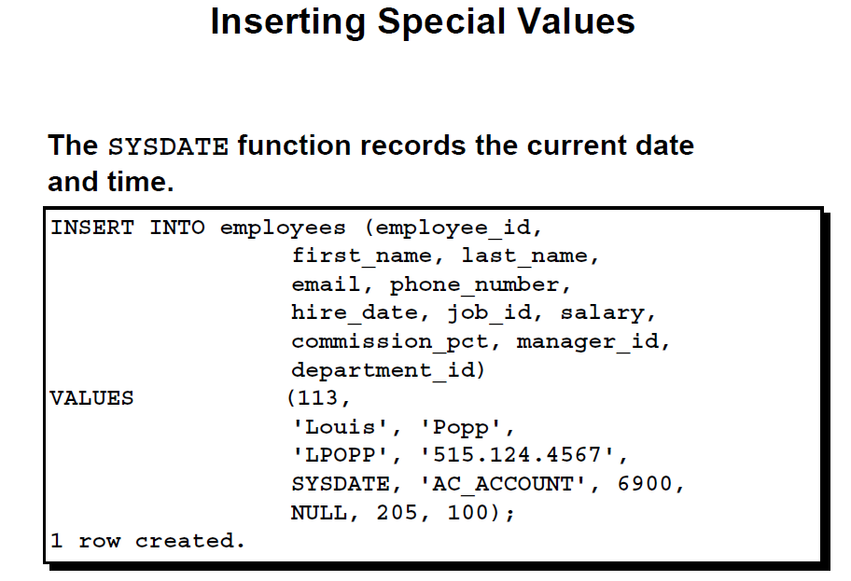
Inserting Special Values

Slide 26
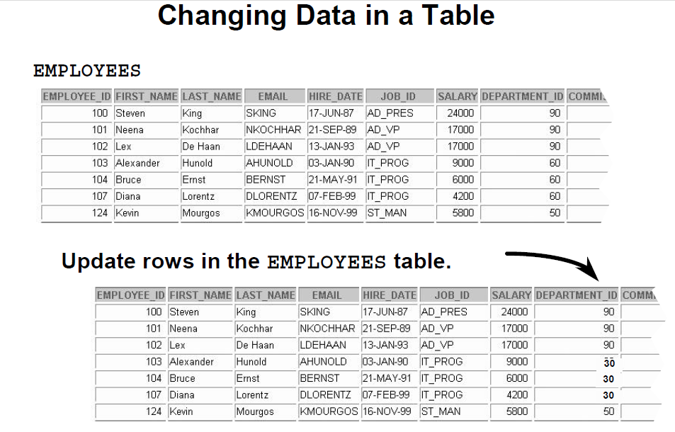
Changing Data in table

Slide 27
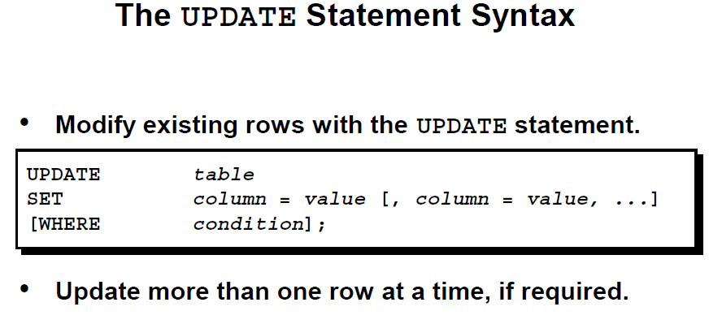
Update Statement

Slide 28
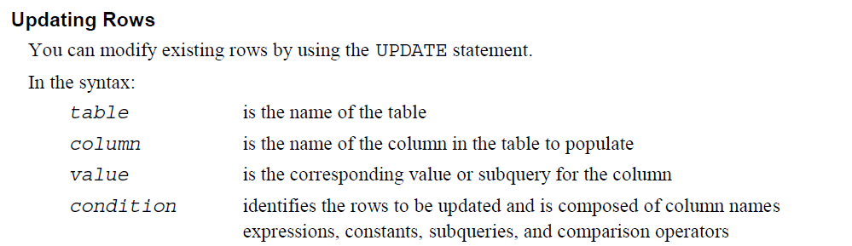
Update Statement

Slide 29
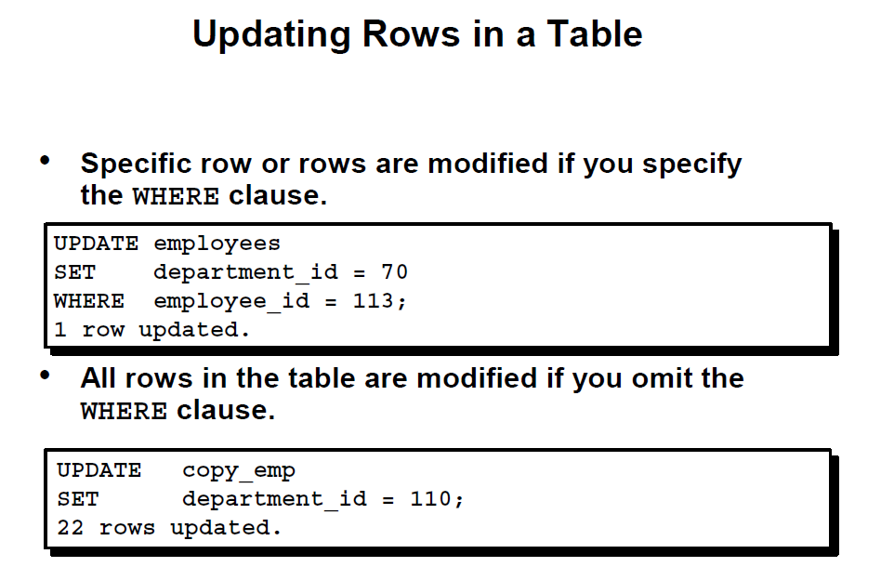
Update Statement

Slide 30
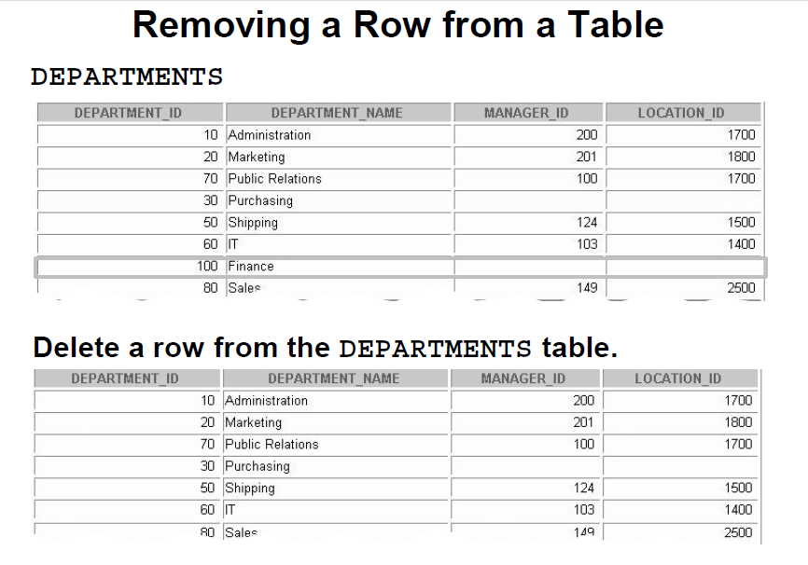
Removing a Row from the department Table

Slide 31
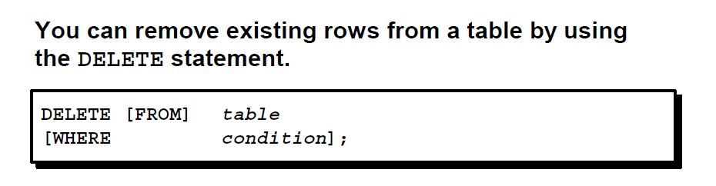
DELETE STATEMENT

Slide 32
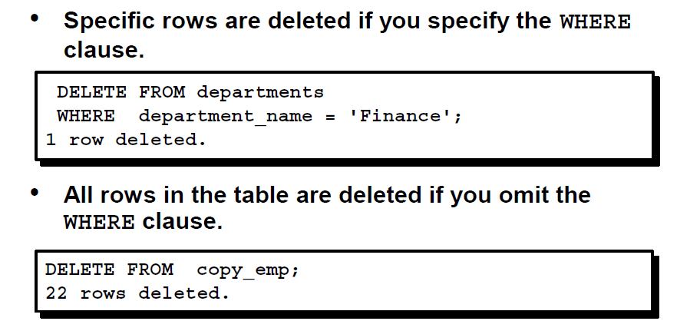
Deleting Row

Slide 33
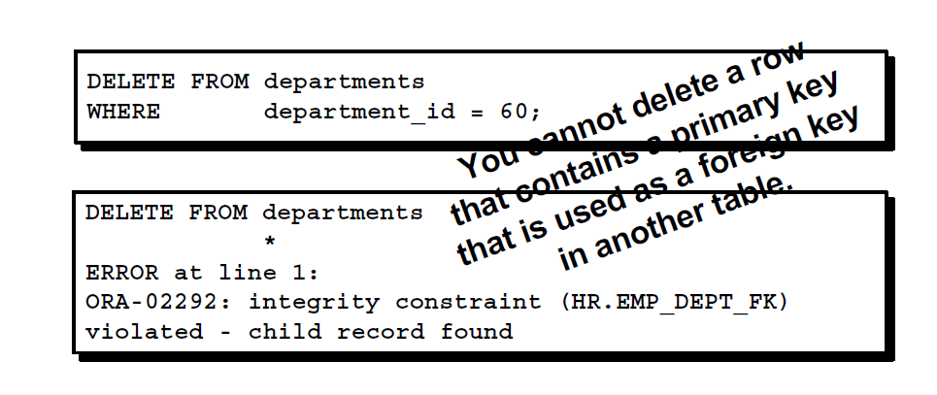
Deleting Rows Integrity Constraint Error

Slide 34
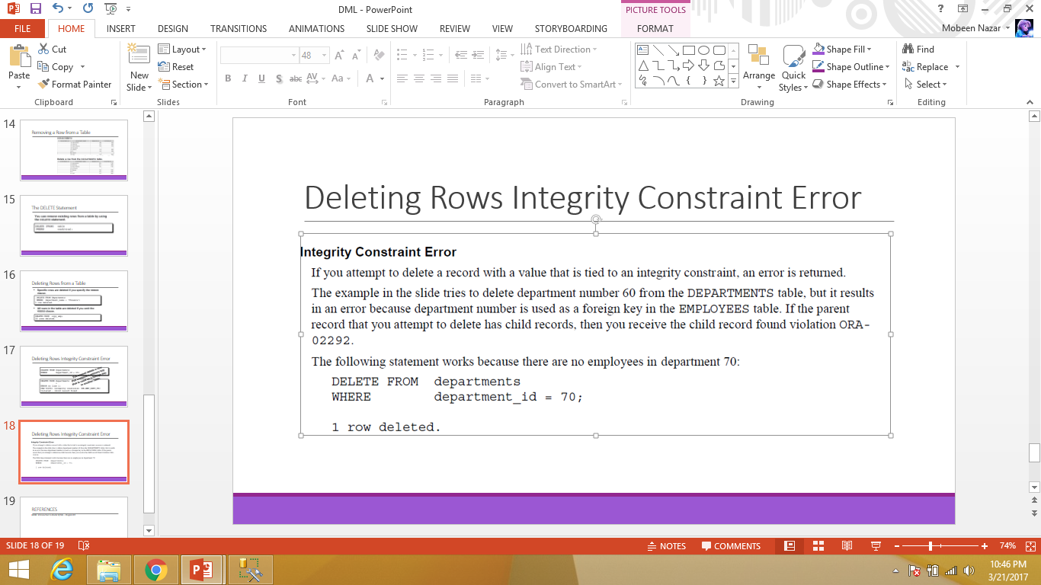
Deleting Record Integrity Constraint Error

